Slide 1
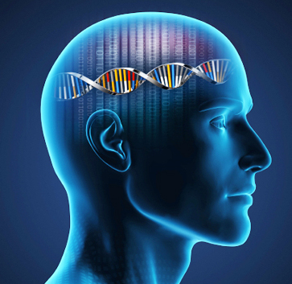
ISRC-CN³ Autumn School 2021
Introductory Neuroscience
Dr Elaine Murray
NI Centre for Stratified Medicine
e.murray@ulster.ac.uk

Slide 2
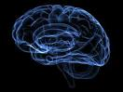
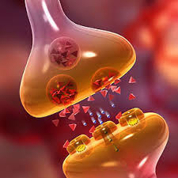
Lecture Outline
Structure of the nervous system
Functional overview of the
Central Nervous System
3. Neuronal Signalling
4. Synaptic Transmission

Slide 3
Overview of the Nervous System

Slide 4
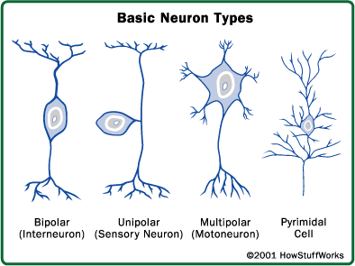
Cells of the Nervous System
Two primary cell types in the nervous system: Neurons and Glia
Neurons: Basic information processing structures of the nervous system

Slide 5
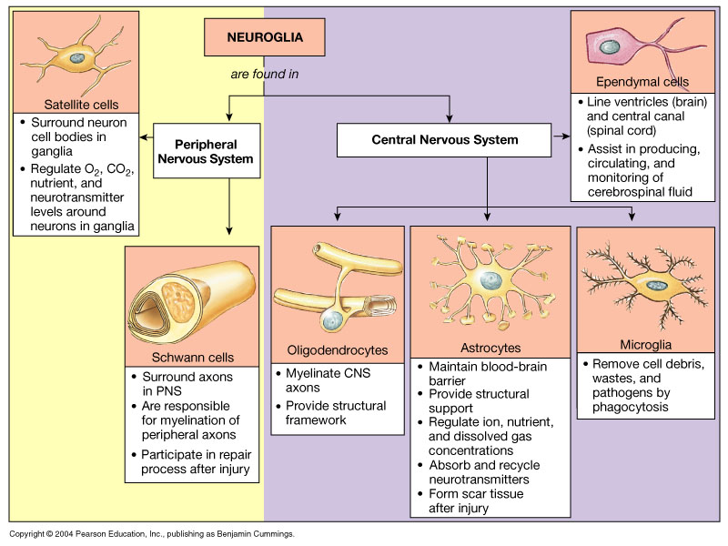
Cells of the Nervous System
Glia: Provide support to neurons; physical support, maintain the chemical environment and provide immunological function.

Slide 6
Basic Neuron Structure
Soma (cell body) – contains the nucleus and other organelles that maintain cell metabolic function.
Dendrites – treelike projections from the soma that receive information from other cells.
Axon is the elongated fiber that extends from the cell body to the terminal endings and transmits the neural signal.

Slide 7

Basic Neuron Structure

Slide 8
Structure of the Nervous System
Central Nervous System
Brain and spinal cord
Peripheral Nervous System
All nerves outside the brain and spinal cord
PNS further sub-divided into:
Somatic system – controls voluntary muscles with both spinal and cranial nerves
Autonomic nervous system – consists of autonomic nerves and some cranial nerves and controls the function of organs and gland

Slide 9
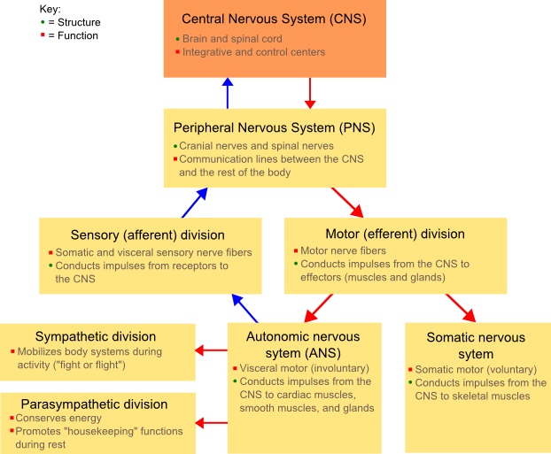
Structure of the Nervous System

Slide 10
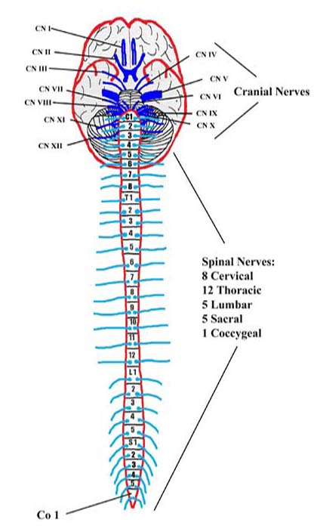
Somatic Nervous System
Spinal nerves (mixed nerves) - consist of many neurons some of which carry sensory information and some carry motor information
Sensory afferents – neurons that carry sensory information from the surface of the body and from muscles into the spinal cord; cell bodies in dorsal root ganglia
Motor efferents – neurons responsible for voluntary movements; begin in the spinal cord and end in ventral horn of spinal cord and end on skeletal muscles
Cranial nerves – provide functions similar to spinal nerves but primarily serve the head and neck. Not all mixed nerves; several have only motor ot sensory function

Slide 11
Autonomic Nervous System
Autonomic nervous system regulate the internal environment smooth muscles and glands such as:
Intestine
Urinary bladder
Cardiac muscle
Adrenal and salivary glands
The purpose of the ANS is to control important bodily functions
Divided into sympathetic and parasympathetic divisions whose functions generally work in opposition to one another
Sympathetic nervous system (‘fight or flight’) – predominates when energy expenditure is necessary e.g. during times of stress, excitement or exertion
Parasympathetic nervous system (‘rest and digest’) – predominates when energy can be conserved and stored for later use

Slide 12
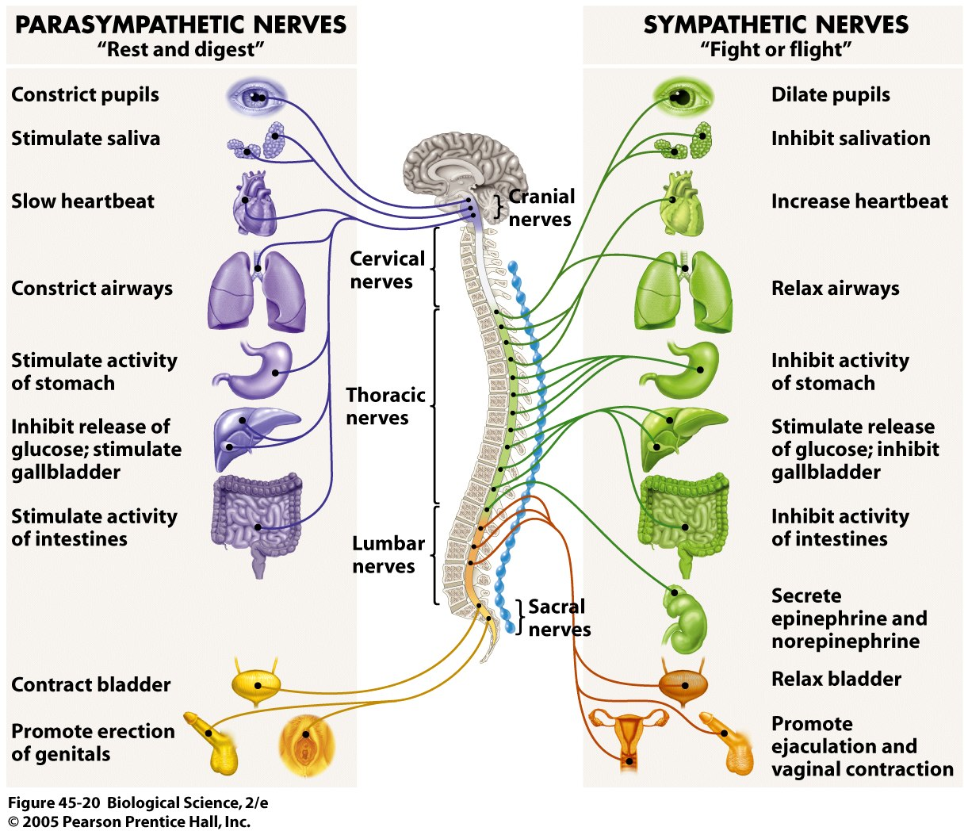
Autonomic Nervous System

Slide 13
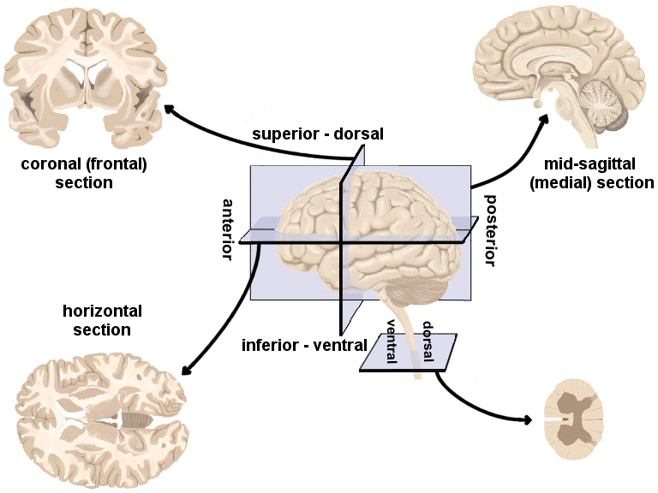
Central Nervous System

Slide 14
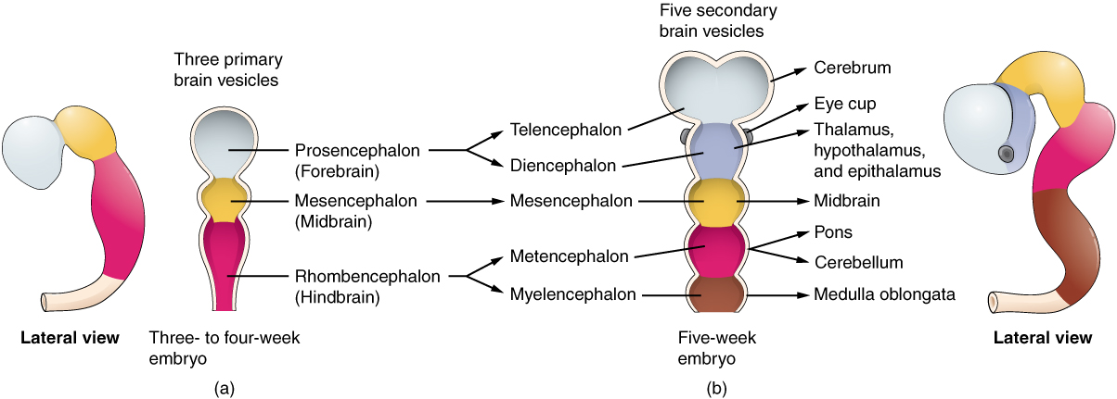
Divisions of the Central Nervous System

Slide 15
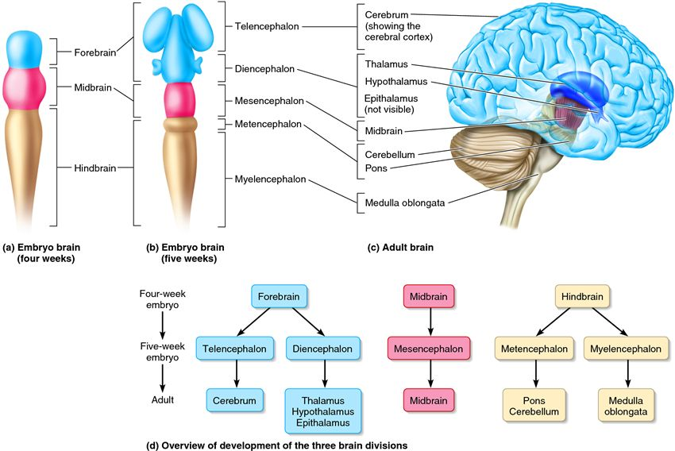
Divisions of the Central Nervous System

Slide 16
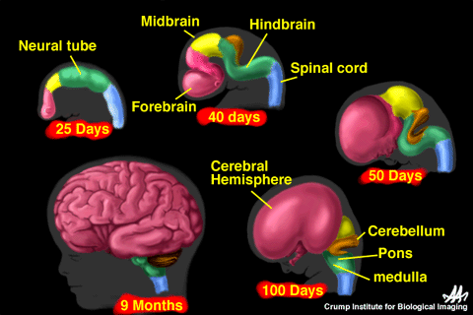
Divisions of the Central Nervous System

Slide 17
CNS Division | Key Structures | Function
Telencephalon | Cerebral Cortex Cerebral hemispheres | Higher brain function such as thought and action.
 | Limbic System Hippocampus, amygdala | Integration of emotional responses Regulation of motivated behaviour Learning and memory
 | Basal Ganglia Caudate, putamen, globus pallidus | Motor control
Diencephalon | Thalamus | Relays information to cortex
 | Hypothalamus | Maintenance of homeostasis of of physiological functions Modulation of motivated behaviours
Mesencephalon | Midbrain | Contains nuclei that control motor movement, particularly movements of the eye, and in auditory and visual processing
Metencephalon | Pons | Motor control and sensory analysis
 | Cerebellum | Regulation and coordination of movement, posture, and balance
Myelencephalon | Medulla | Maintaining vital body functions

Slide 18
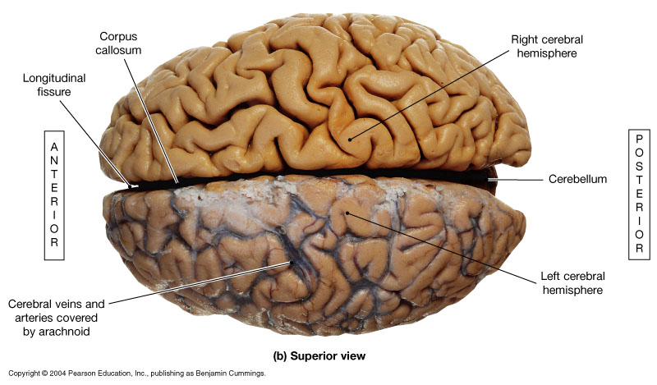
External surface of the brain

Slide 19
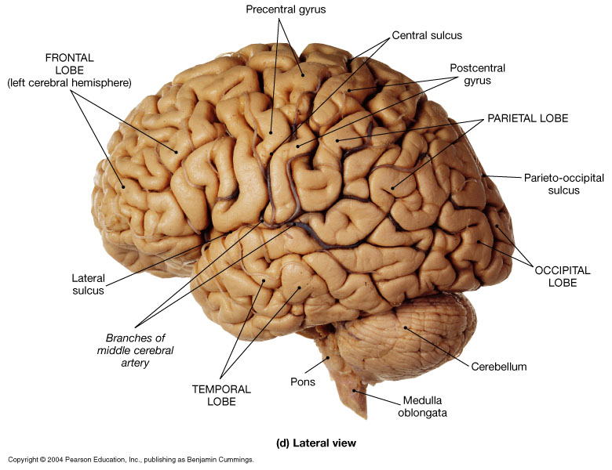
External surface of the brain

Slide 20
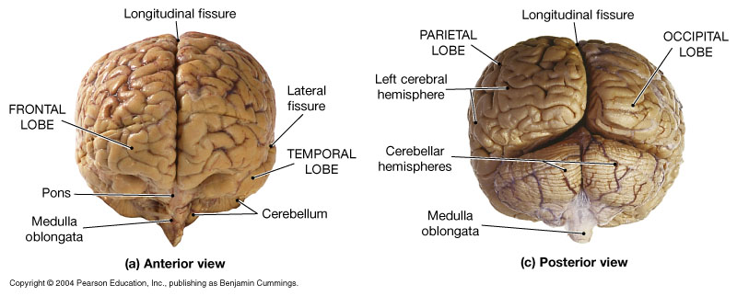
External surface of the brain

Slide 21
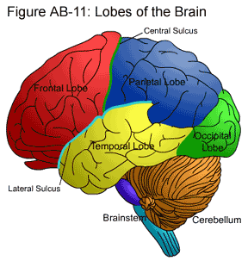
External surface of the brain

Slide 22
Cerebral Cortex
Cerebral cortex – two hemispheres connected by the corpus callosum
Divided into four lobes based on function:
Frontal lobe - associated with reasoning, planning, parts of speech, movement, emotions, and problem solving
Parietal lobe - associated with movement, orientation, recognition, perception of stimuli
Occipital lobe - associated with visual processing
Temporal lobe - associated with perception and recognition of auditory stimuli, memory, and speech

Slide 23
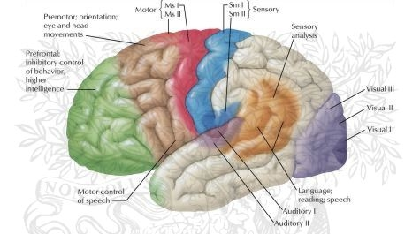
Cerebral Cortex

Slide 24
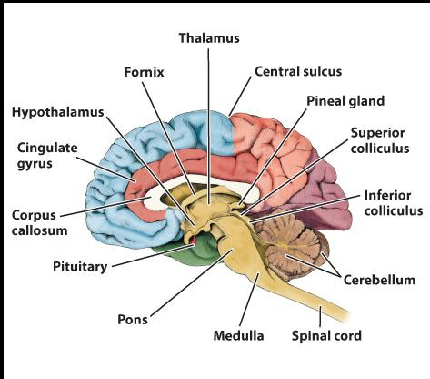
Mid-sagittal View

Slide 25
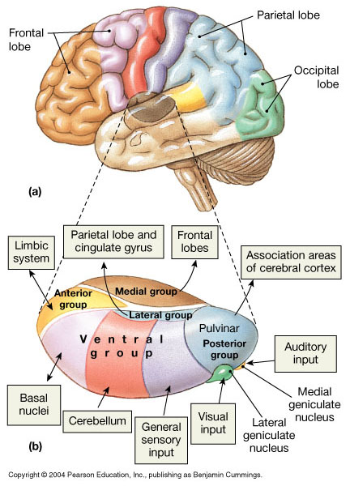
Thalamus
Final relay point for ascending sensory information
Coordinates the activities of the cerebral cortex and basal nuclei
Domain-specific information processing

Slide 26
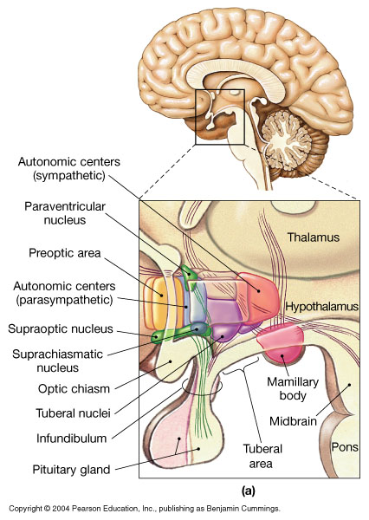
Hypothalamus
Controls somatic motor activities at the subconscious level
Controls autonomic function
Coordinates activities of the endocrine & nervous systems
Secretes hormones
Produces emotions and behavioral drives
Regulates body temperature
Coordinates circadian cycles of activity
4Fs: feeding, fighting, fleeing, and reproductive behavior

Slide 27
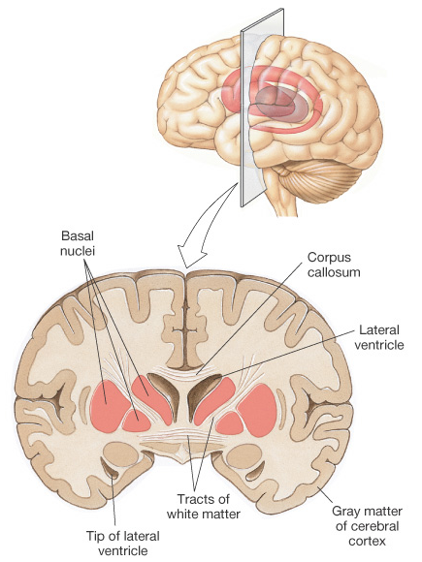
Basal Ganglia
Primary functions
Regulate muscle tone throughout the body
Initiate and maintain voluntary movements while suppressing involuntary movements
Maintenance of posture and balance

Slide 29
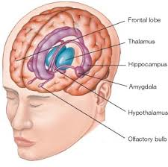
The Limbic System
The limbic system is responsible for controlling various functions in the body.
Some of these functions include interpreting emotional responses, storing memories, and regulating hormones.
The limbic system is also involved with sensory perception, motor function, and olfaction.

Slide 30
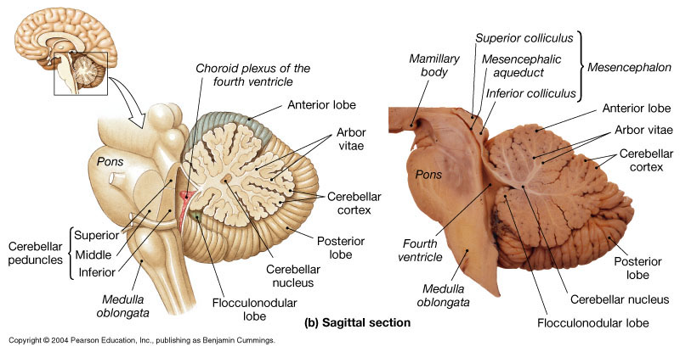
Cerebellum
It controls:
Posture
Balance
Voluntary movements

Slide 31
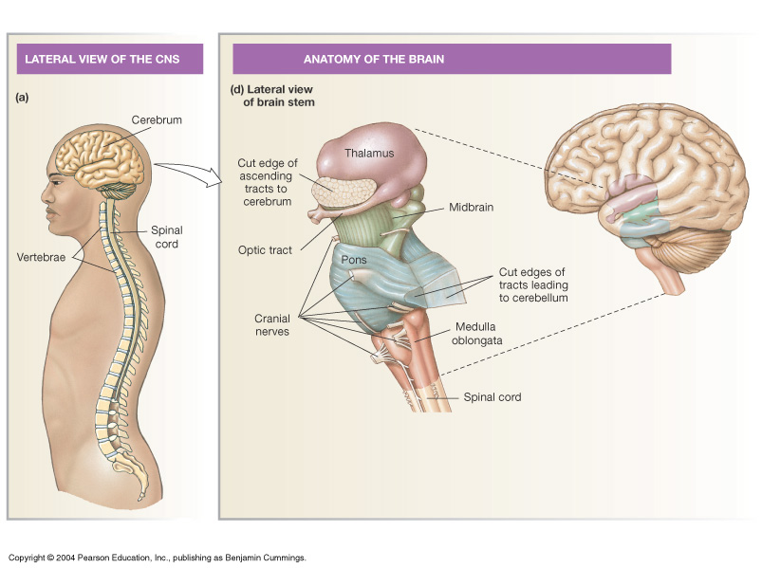
Brain Stem: Midbrain, Pons & Medulla
An important link between spinal cord and higher brain levels, relays motor and sensory impulses between other “higher” parts of the brain and spinal cord
Midbrain – eye movement control
Pons/Medulla - Signal relay & Involuntary functions

Slide 32
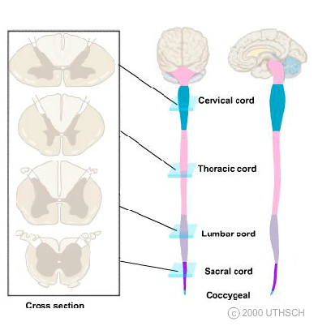
Spinal Cord
The spinal cord is a cylindrical structure of nervous tissue composed of white and gray matter, is uniformly organized and is divided into four regions:
cervical (C),
thoracic (T),
lumbar (L) and
sacral (S),
each of which is comprised of several segments

Slide 33
Cerebrospinal Fluid (CSF)
CSF surrounds the brain and spinal cord and has three main functions:
Protection - acts as a cushion for the brain, limiting neural damage in cranial injuries
Buoyancy - By being immersed in CSF, the net weight of the brain is reduced to approximately 25 grams. This prevents excessive pressure on the base of the brain.
Chemical Stability - The CSF creates an environment to allow for proper functioning of the brain. E.g. Maintaining low extracellular K+ for synaptic transmission.

Slide 34
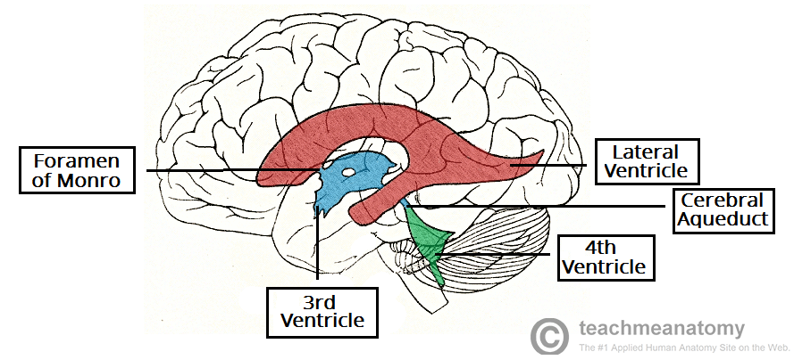
Ventricular System
Ventricles are structures that produce and circulate CSF around the brain
Lined by ependymal cells that form a structure called the choroid plexus which is where CSF is produced

Slide 35
Meninges
The main functions of the meninges are:
1. Protecting the brain and spinal cord from mechanical injury
2. Providing blood supply to the skull and to the hemispheres
3. Providing a space for the flow of cerebrospinal fluid.

Slide 36
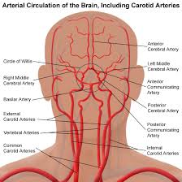
Blood Supply to the Brain

Slide 37
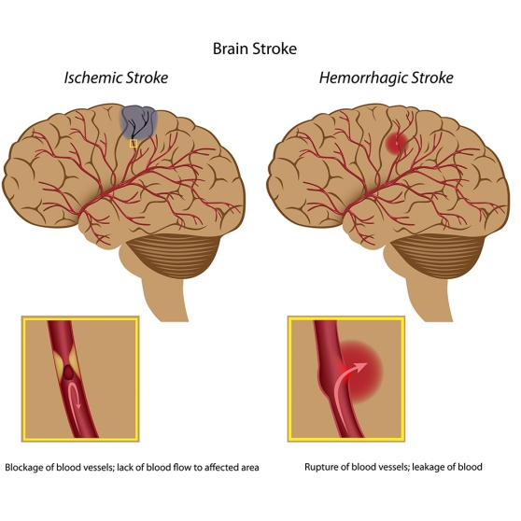

Slide 38
Blood-brain Barrier
A semipermeable membrane separating the blood from the cerebrospinal fluid,
Allows the passage of water and some small molecules like amino acids
Prevents larger lipophilic molecules and potential neurotoxins from entering the brain
A small number of regions in the brain, including the circumventricular organs (CVOs), do not have a blood–brain barrier.
Distinct morphology of capillaries, adjoining edges of endothelial cells are fused forming tight junctions.
Protects the brain but also makes drug delivery to the brain difficult.

Slide 39
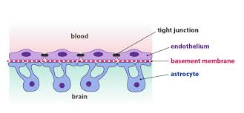
Blood-brain Barrier

Slide 40
Overview of Signaling in the nervous system.

Slide 41
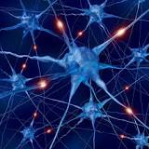
Communication between neurons
Action Potential Video
https://www.youtube.com/watch?v=FEHNIELPb0s

Slide 42
Basic Neuron Structure
https://www.youtube.com/watch?v=6qS83wD29PY

Slide 43
Ion Channels
Present on cell membrane of neurons
Present on membrane to allow transport of charged particles such as potassium (K+), sodium (Na+), chloride (Cl-), and calcium (Ca2+) through the membrane
Protein molecules that penetrate through the membrane and have water-filled pore through which ions pass
Relatively specific for a particular ion, although some do allow more than one type of ion to pass through

Slide 44
Ion Channels
Gated channels - normally in a closed configuration but open momentarily in response to specific stimuli to allow passage of ions
Ligand-gated channels – channel protein changes shape and opens, allowing flow of an ion, following a ligand (e.g. neurotransmitter, hormone or drug) binding to a receptor that recognizes the ligand.
Voltage-gated channels - channel opened by a small electrical charge to the membrane surrounding the channel
Direction which an ion flows is determined by relative concentration; always travels from high to low concentration (Na+, Cl-, Ca2+ out; K+ in)
Open only briefly and then closes again, limiting total ion flux

Slide 45
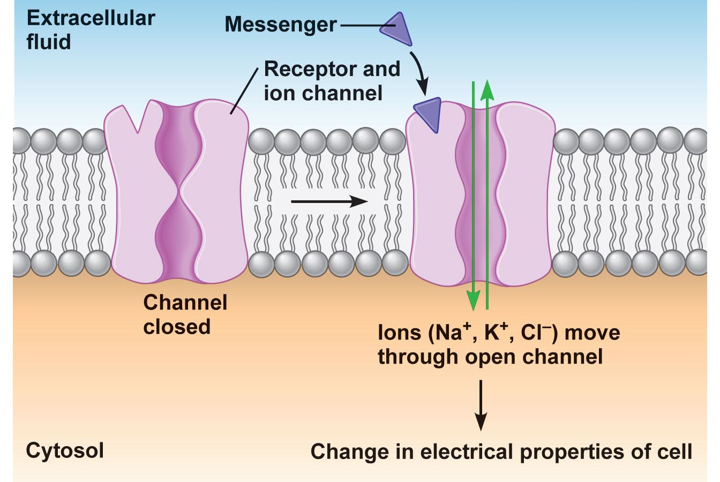
Ligand-gated Ion Channel

Slide 46
Voltage-gated Ion Channel
Voltage-regulated (voltage-gated) sodium channel
Na⁺
Na⁺
Na⁺
Activation gate
Outside cell
Outside cell
Inside cell
Inside cell
Inactivation gate
Resting
(-70 mV)
Activated
(-60 to +30 mV)
Inactivated
(+30 mV, delayed)

Slide 47
Electrical Transmission within a Neuron
Transmission of information within a single neuron is an electrical process
Incoming signal from another cell
Threshold reached
Action Potential
(Electrical signal)
Conveys message along axon to axon terminals

Slide 48
Resting Potential
Resting membrane potential – difference in electrical charge inside the cell compared with outside the cell
The inside of a neuron is more negative than the outside of a neuron
Difference is roughly -70mV
Neurons are polarized in their resting state, meaning there is ‘potential’ for current to flow
Membrane potential caused by:
Selective permeability of the membrane
Uneven distribution of ions inside and outside the cell
More negatively charged ions inside the cell
More positively charged ions outside

Slide 49
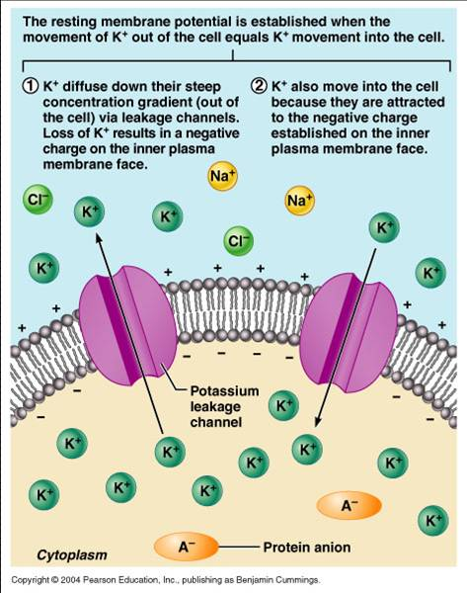
Distribution of ions inside and outside a neuron at resting potential
Differences in ionic makeup
Inside the neuron has lower concentration of Na⁺ and Cl– than outside
Inside has higher concentration of K⁺ and negatively charged proteins (A–) than outside

Slide 50
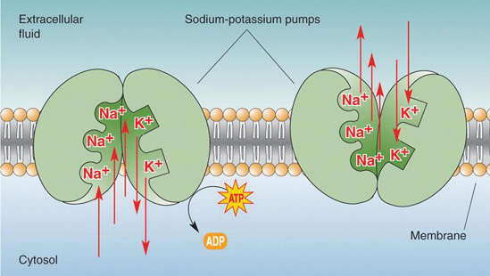
Resting Membrane Potential
Negative interior of the cell is due to much greater diffusion of K⁺ out of the cell than Na⁺ diffusion into the cell
Sodium-potassium pump stabilizes the resting membrane potential by maintaining the concentration gradients for Na⁺ and K⁺
For every 3 Na+ ions that are pumped out, 2 K+ are pumped in, keeping the inside of the cell negative
Notes:
Because K+ is always leaking out and Na+ is always leaking in – you would think the concentrations would eventually even out BUT the Na-K pump transports Na out and K in to maintain concentration differences.

Slide 51
Changes in membrane potential
Membrane potential changes when:
Ion concentrations on two sides change
Permeability of membrane to ions changes
Changes in membrane potential are signals used to receive, integrate and send information

Slide 52
Types of membrane potential difference
Resting potential
Membrane potential of neurons in resting state.
Action potential
Brief, stereotyped (“all-or-none”) change of membrane potential in the positive direction during excitation of cells.
Amplitude: around 100 mV.
Duration: nerve cells around 1.5 ms
Electrotonic potential
Positive (depolarizing) or negative (hyperpolarizing) departure from resting potential due to flow of current across membrane.
Depolarizing current acts as a stimulus (i.e. triggers an action potential when a threshold is reached).
Synaptic potential
Depolarizing (excitatory) or hyperpolarizing (inhibitory) departure from resting potential due to activation of excitatory or inhibitory synapses.

Slide 53
Changes in membrane potential
1
Resting potential
2
2
Action potential
Puncture
3
Electrotonic potential
0
4
Synaptic potential
mV
4
3
1
-70
Stimulating current
Stimulus

Slide 54
Changes in membrane potential
Depolarization
A reduction in membrane potential (toward zero)
Inside of the membrane becomes less negative than the resting potential
Increases the probability of producing a nerve impulse
Hyperpolarization
An increase in membrane potential (away from zero)
Inside of the membrane becomes more negative than the resting potential
Reduces the probability of producing a nerve impulse

Slide 55
Membrane Potentials That Act as Signals
Two types of signals:
Graded potentials
Incoming short-distance signals
Action potentials
Long-distance signals of axons

Slide 56
Graded Potentials
Occur when a stimulus causes gated ion channels to open
E.g., receptor potentials, generator potentials, postsynaptic potentials
Magnitude varies directly (graded) with stimulus strength
Decrease in magnitude with distance as ions flow and diffuse through leakage channels
Short-distance signals

Slide 57
Action Potentials
Brief reversal of membrane potential with a total amplitude of ~100 mV
Occurs in muscle cells and axons of neurons
Does NOT decrease in magnitude over distance
Principal means of long-distance neural communication

Slide 58
Graded Potentials vs. Action Potentials
Graded Potential
Action Potential
Chemically gated ion channels
Stimulus is related to the strength
Die out with increasing distance
Due to leakage of the charge
Short distance travel
Voltage gated ion channels
Stimulus is consistent
Do not decrease with distance
Long distance travel
**Graded Potentials can cause Action Potentials

Slide 59
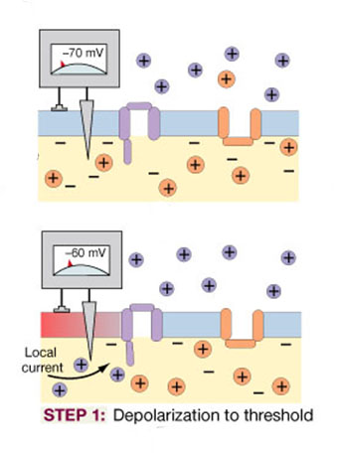
Generation of an action potential
Membrane at rest
Channels inactive and resting potential maintained
Step 1: Depolarization to threshold
Graded depolarization (local current) brings an area of excitable membrane to threshold (-60 to -55 mV).

Slide 60
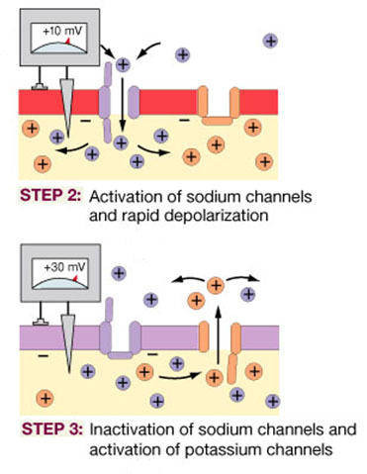
Generation of an action potential
Step 2: Activation of sodium channels
and rapid depolarization
Voltage-regulated sodium channels open (sodium channel activation).
Sodium ions, driven by charge attraction and concentration gradient, flood into the cell.
Transmembrane potential goes from -60 mV (threshold) to +30 mV.
Step 3: Inactivation of sodium channels
and activation of potassium channels
Voltage-regulated sodium channels close (sodium channel inactivation).
Voltage-regulated potassium channels are now open and potassium ions move out of cell.
Repolarization begins.

Slide 61
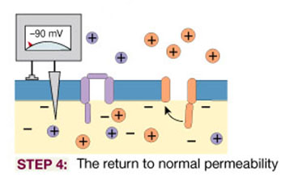
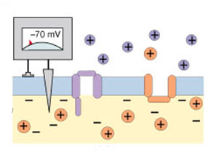
Generation of an action potential
Step 4: Return to normal permeability
Voltage-regulated sodium channels regain their normal properties when threshold is reached (-60 mV).
Voltage-regulated potassium channels begin closing at -70 mV. As they close slowly a temporary hyperpolarization occurs.
At end of the relative refractory period, all voltage-regulated channels have closed and membrane is back to its resting state.
Resting state

Slide 62
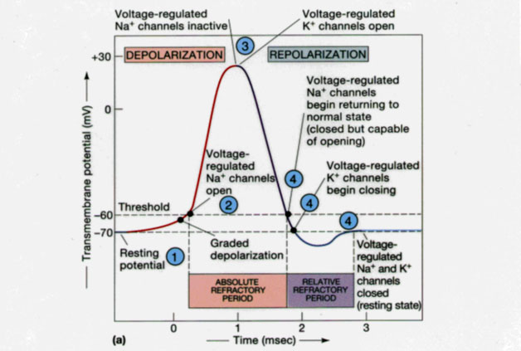
Changes during an action potential

Slide 63
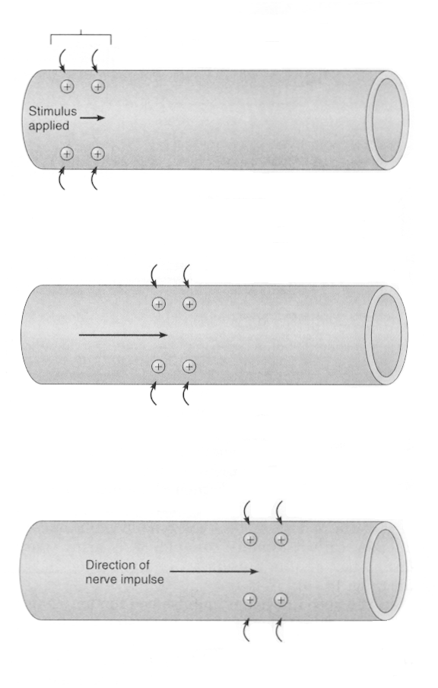
Region of action
potential
+
+
+
+
+
+
+
+
+
+
Movement of action potential
+
+
+
+
+
+
+
+
+
+
+
+
+
+
+
+
+
+
+
+
+
+
+
+
+
+
+
+
+
+
+
+
+
+
+
+
+
+
(A)
(B)
+
+
(C)
An action potential in one region (A) stimulates the adjacent region, and (B and C) a wave of action potentials (a nerve impulse) moves along the fibre.
+
+
+
+
+
+
+
+
+
+

Slide 64
Propagation of a nerve impulse
An action potential is propagated (“handed-on”) with same shape and size along whole length of the axon or muscle cell.
One particular action potential does not itself travel along the membrane.
Each action potential activates voltage-regulated channels in the adjacent part of the membrane and a new action potential occurs there. This, in turn, triggers the next region of the membrane and the process is repeated again and again along the nerve.
Local
current
flow
+
+
+
+
+
+
-
-
-
-
+
+
+
+
+
+
+
+
+
-
-
-
-
-
-
+
+
+
+
-
-
-
-
-
-
-
-
-
Depolarized
region
Repolarized
region
Propagation
-
-
-
-
-
-
+
+
+
+
-
-
-
-
-
-
-
-
-
+
+
+
+
+
+
-
-
-
-
+
+
+
+
+
+
+
+
+

Slide 65
Propagation of a nerve impulse
Velocity of propagation
Action potentials travel along axons at speeds of 0.1-100 metres per second (fast but slower than electrical currents in wires of 3 x 10⁻⁸ m/s).
This means nerve impulses can get from one part of a body to another in a few milliseconds allowing fast responses to stimuli.
Depends on:
Diameter of neuron (generally larger the fibre the faster the propagation).
Resistance to current leaking from the neuron membrane (myelin sheath reduces current leakage considerably).
Temperature (generally higher the temperature the faster the propagation).

Slide 66
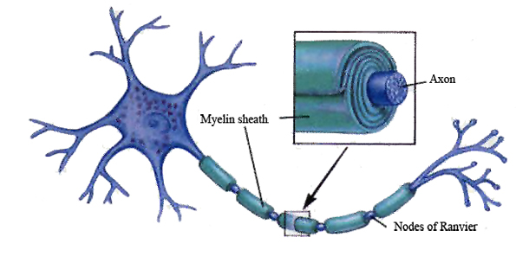
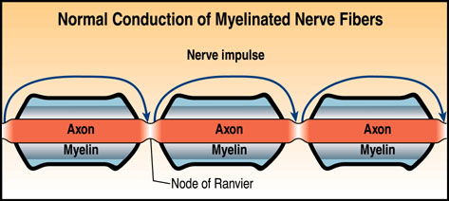
Myelination
- Myelin is produced by specific types of glial cells (oligodendrocytes- CNS; Schwann cells – PNS)
- Layers of myelin wrap around axons and provide electrical insulation to the neuron.

Slide 67
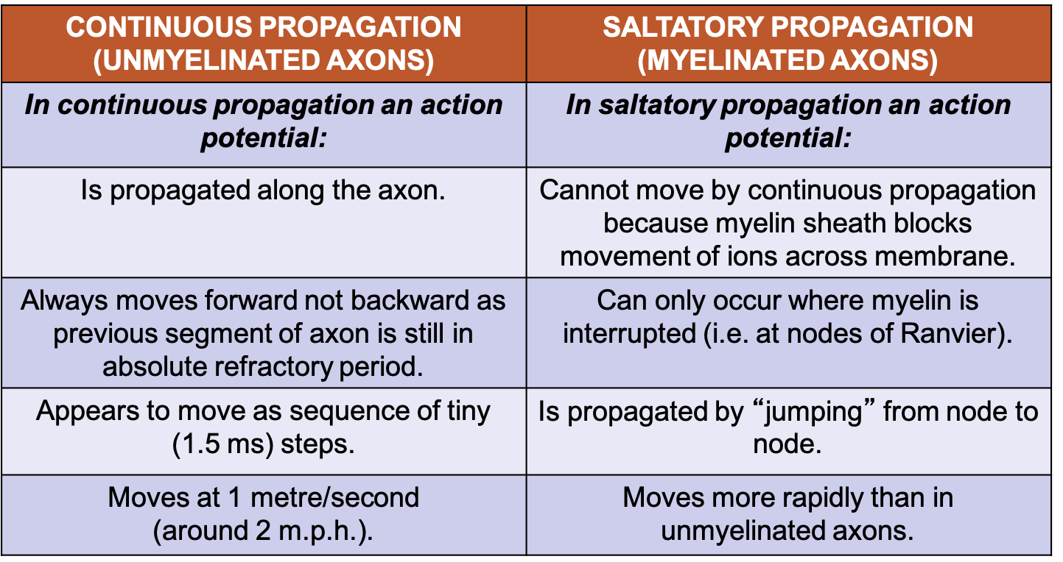
Myelination

Slide 68
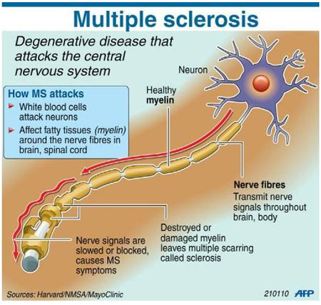
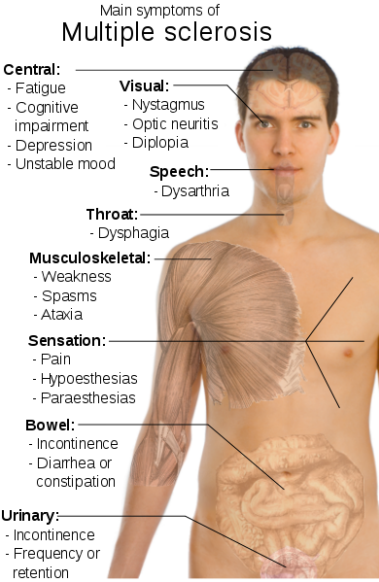
Demyelinating Disease

Slide 69
Synaptic Transmission
Synaptic Transmission
https://www.youtube.com/watch?v=WhowH0kb7n0

Slide 70
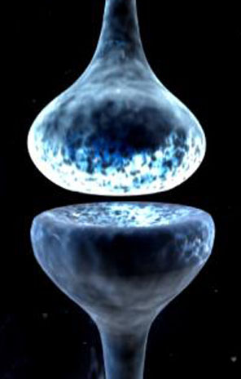
The Synapse
What is a synapse?
A synapse is a specialized junction through which impulses pass from a presynaptic neuron to another (postsynaptic) cell (synaptic transmission).
Or, in more basic terms, a place where two membranes can communicate.
May be electrical, relying on direct physical contact, or chemical, relying on the actions of a neurotransmitter.

Slide 71
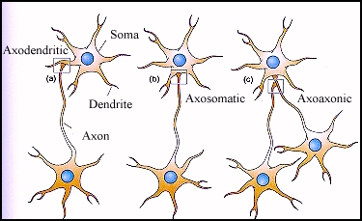
Types of Synapses
Axodendritic
Between the axon of one neuron and the dendrite of another
Axosomatic
Between the axon of one neuron and the soma of another

Slide 72
Synaptic communication
Electrical synapses
Very rare.
Located in the central and peripheral nervous systems.
Presynaptic and postsynaptic membranes are “locked” together at gap junctions.
Communication between the membranes occurs very efficiently, almost as quick as if they shared the same cell membrane.
Action potential arriving at electrical synapse will always be propagated to the next cell.

Slide 73
Synaptic communication
Chemical synapses
Most abundant type of synapse
Cells are not directly coupled and so an action potential may or may not release enough neurotransmitter to bring postsynaptic membrane to synapse.
Activity can be regulated by a variety of factors.
Generally communication occurs in only one direction.
Neurotransmitters involved in synapse are classified as either excitatory or inhibitory.
The absolute effect of a neurotransmitter on postsynaptic membrane depends on the properties of the receptor, not on the nature of the neurotransmitter.

Slide 74
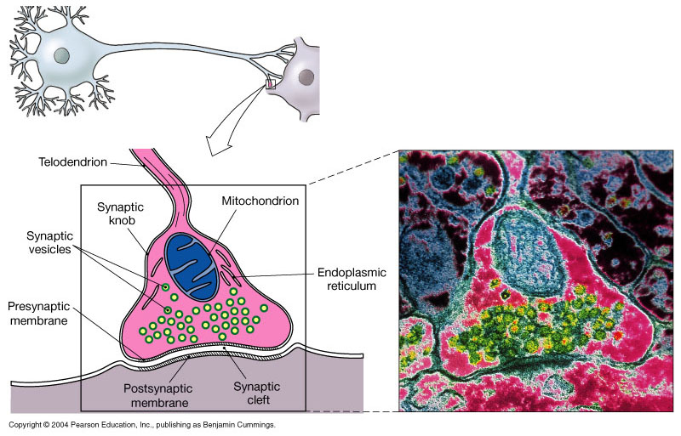
Chemical Synapse

Slide 75
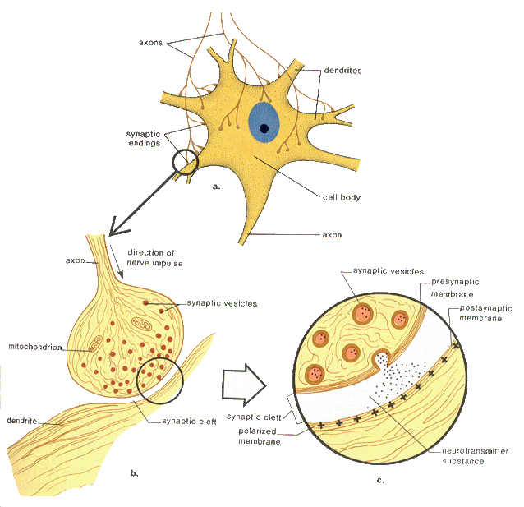
Synaptic Cleft
Transmission across the synaptic cleft:
Is a chemical event (as opposed to an electrical one)
Involves release, diffusion, and binding of neurotransmitters
Ensures unidirectional communication between neurons

Slide 76
Ion channel-linked receptor and G-protein coupled receptors
The binding of the neurotransmitter to its receptors can influence the postsynaptic neuron in one of two fundamentally different ways:
It can directly influence chemical-gated channels in the postsynaptic membrane and induce brief EPSPs or IPSPs; or
It can trigger chemical reactions in the cytoplasm of the postsynaptic neuron that lead to the production of chemicals, called secondary messengers (e.g., cyclic AMP), which can have more enduring and far-reaching effects on the sensitivity of the neuron

Slide 77
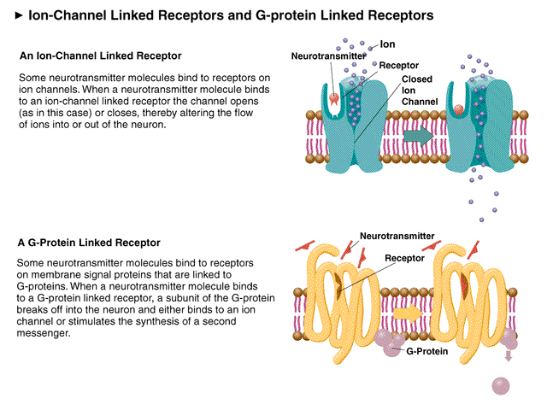
Ion channel-linked receptor and G-protein coupled receptors

Slide 78
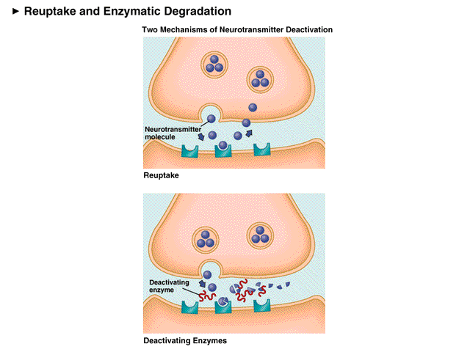
Termination of Neurotransmitter Effects
Within a few milliseconds, the neurotransmitter effect is terminated
Degradation by enzymes
Reuptake by astrocytes or axon terminal
Diffusion away from the synaptic cleft

Slide 79
Synaptic Delay
Synaptic Delay:
Neurotransmitter must be released, diffuse across the synapse, and bind to receptors
Synaptic delay—time needed to do this (0.3–5.0 ms)
Synaptic delay is the rate-limiting step of neural transmission

Slide 80
Postsynaptic Potentials
Graded potentials
Strength determined by:
Amount of neurotransmitter released
Time the neurotransmitter is in the area
Types of postsynaptic potentials
EPSP—excitatory postsynaptic potentials
IPSP—inhibitory postsynaptic potentials

Slide 81
Postsynaptic Potentials
Excitatory Synapses and EPSPs
Neurotransmitter binds to and opens chemically gated channels that allow simultaneous flow of Na⁺ and K⁺ in opposite directions
Short distance signaling
Moves the polarity towards AP
Inhibitory Synapses and IPSPs
Neurotransmitter binds to and opens channels for K⁺ or Cl–
Causes a hyperpolarization (the inner surface of membrane becomes more negative)
Reduces the postsynaptic neuron’s ability to produce an AP

Slide 82
Neurotransmitters
Most neurons make two or more neurotransmitters, which are released at different stimulation frequencies
50 or more neurotransmitters have been identified
Classified by chemical structure and by function

Slide 83
Neurotransmitters – Structural Classification
Acetylcholine (ACh)
Amino acids
Aspartate
Gamma-aminobutyric acid
Glutamate
Glycine
Biogenic amines
Dopamine (DA)
Adrenaline
Histamine
Noradrenaline (NE)
Serotonin (5-HT)
Gases
Nitric oxide (NO)
Carbon monoxide (?)
Neuropeptides
Angiotensin II
Antidiuretic hormone (vasopressin)
Atrial naturetic peptide (ANP)
Bombesin
Choleocystokinin (CCK)
Corticotrophin
Dynorphins
Endorphins
Enkephalins (Enk)
Galanin
Gastrin
Glucagon
Hypothalmic regulating hormones
Neuropeptide Y
Neurotensin
Oxytocin
Substance P
Vasoactive intestinal polypeptide (VIP)

Slide 84

Neurotransmitter Families

Slide 85
Neurotransmitters – Functional Classification
Excitatory and inhibitory neurotransmitters are present in both central and peripheral nervous systems.
Sometimes same neurotransmitter is excitatory in one location but inhibitory in another, therefore response is dependent on receptor.
Excitatory neurotransmitters
Glutamate (brain, brain stem).
Aspartate (spinal cord).
Inhibitory neurotransmitters
Gamma-aminobutyric acid, or GABA (brain).
Glycine (primarily spinal cord, brain).

Slide 86
Conditions and agents altering impulse conduction
Chemical and physical environment of neuron influences impulse conduction and synaptic transmission.
Alkalosis | Defined as an increase in pH above 7.45. Increases excitability of neurons, giving rise to inappropriate impulses. Range of effects from light-headedness right through to convulsions.
Acidosis | Defined as decrease of pH below 7.35. Results in progressive depression of neuronal activity. Range of effects from apathy through to coma.
Excessive pressure | If nerve is subjected to excessive or prolonged pressure, impulse conduction can be blocked.
Agonist | Agent that enhances synaptic transmission or mimics effect of natural neurotransmitter.
Antagonist | Agent that blocks the action of a neurotransmitter.

Slide 87
Agonist and antagonist binding
Beta-blocker
Lock-and-key concept
Binding of the ‘key’ (messenger substance) to the ‘lock’ receptor transmits information.
Each communication system uses somewhat different ‘keys’ and ‘locks’.
beta-receptor
Cell membrane
Isoproterenol
Adrenaline
alpha-receptor
Noradrenaline
Cell membrane
Alpha-blocker

Slide 88


Slide 89


Slide 90
Disorders associated with neurotransmitter imbalances
Condition | Main symptoms | Imbalance of neurotransmitter in brain
Alzheimer’s disease | Memory loss, dementia | Deficient acetylcholine
Clinical depression | Debilitating inexplicable sadness | Deficient noradrenaline and/or serotonin
Epilepsy | Seizures, loss of consciousness | Excess GABA leads to excess noradrenaline and dopamine
Huntington’s disease | Personality changes, uncontrollable movements | Deficient GABA
Insomnia | Inability to sleep | Excess noradrenaline
Myasthenia gravis | Progressive muscular weakness | Deficient acetylcholine receptors at neuromuscular junctions
Parkinson’s disease | Tremors of hands, slowed movements, muscle rigidity | Deficient dopamine
Schizophrenia | Inappropriate emotional responses, hallucinations | Deficient GABA leads to excess dopamine

Slide 91
Drugs that alter neurotransmitter levels
Drug | Neurotransmitter affected | Mechanism of action | Effect
Curare | Acetylcholine | Decreases neurotransmitter in synaptic cleft | Muscle paralysis
Reserpine | Noradrenaline | Packaging neurotransmitter into vesicles | Limb tremors
Cocaine | Noradrenaline | Blocks reuptake | Euphoria
Monoamine oxidase inhibitors | Noradrenaline | Blocks enzymatic degradation of neurotransmitter in presynaptic cell | Mood elevation
Tryptophan | Serotonin | Simulates neurotransmitter synthesis | Sleepiness
Prozac and related drugs | Serotonin | Blocks reuptake | Mood elevation
Valium | GABA | Enhances receptor binding | Decreases anxiety

